Slide 1

DESIGN THINKING AND INNOVATION
Dr D. Venkata Subbaiah
Professor, CSE Department
Lakireddy Bali Reddy College of Engineering (A), Mylavaram

Slide 2
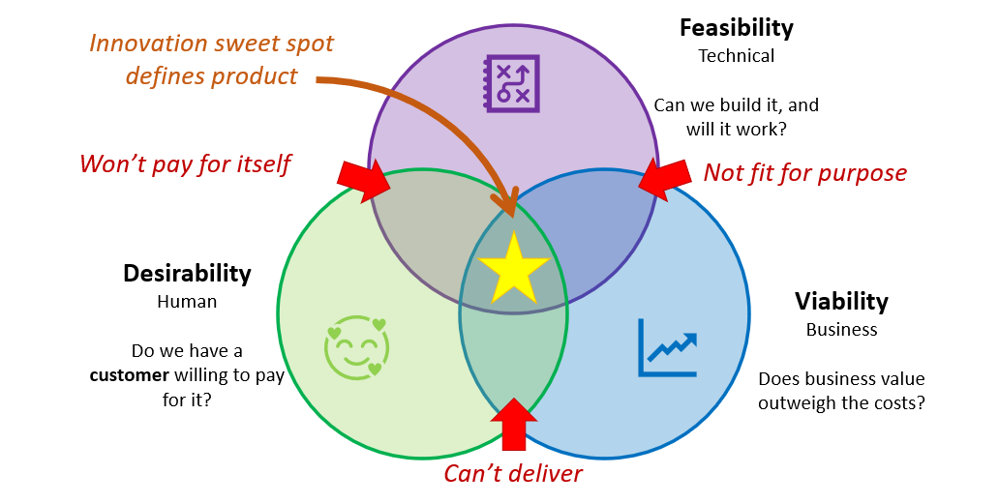
Elements of Design Thinking
Innovation/Outcome

Slide 3
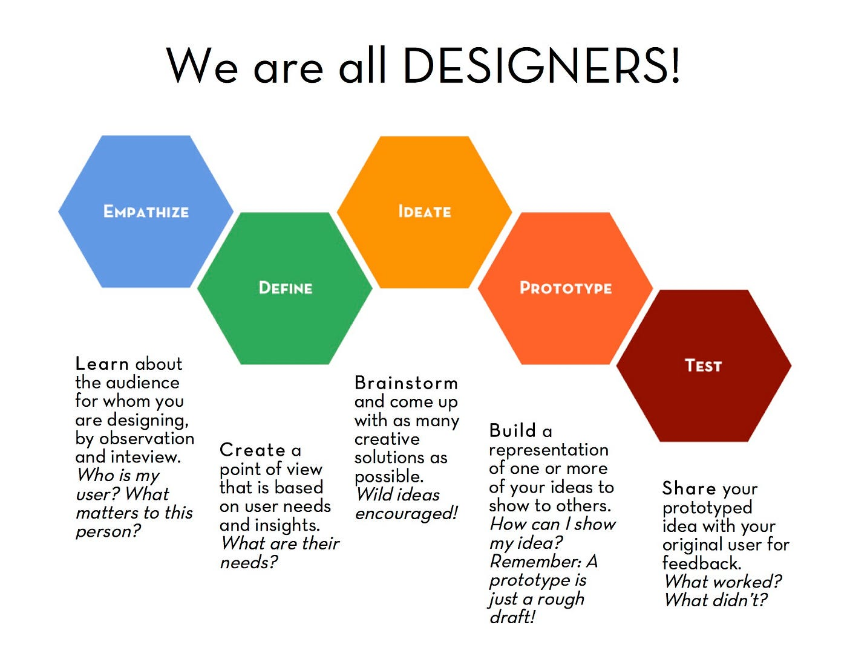
Elements of Design Thinking
INSIGHTS
NEEDS
CONCEPTS
MODELS
REFINE

Slide 4

Design Thinking Tools
Persona
Customer Journey Maps
Brainstorming
Empathy Mapping
Story Boarding
Prototyping Tools
SWOT Analysis

Slide 5
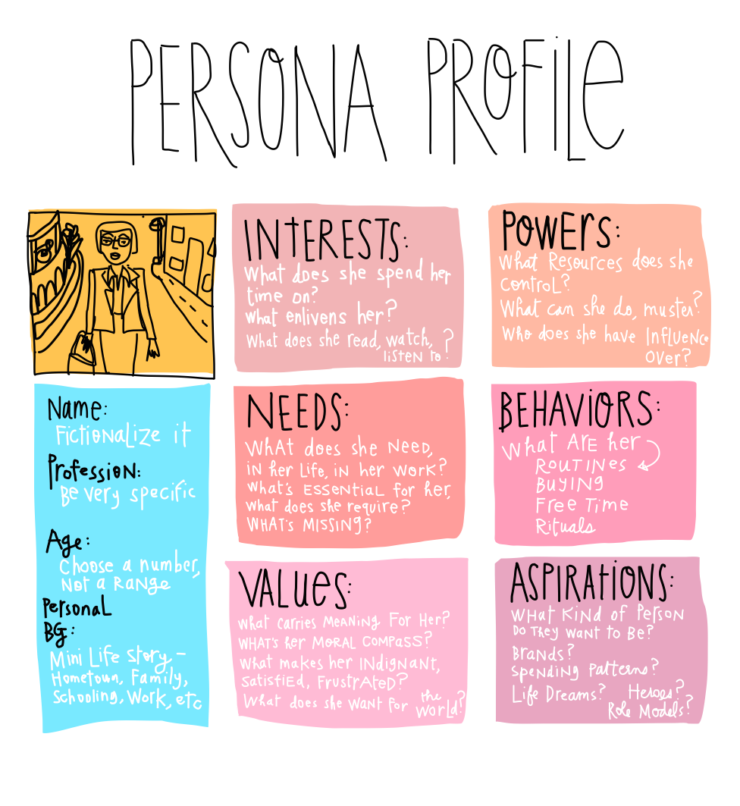
Design Thinking Tools: Persona
PERSONA
A brief CV of a person or Customer or User with short information
It highlights his particulars, Interests, Aspirations, Challenges, Needs, Values and Behaviors followed by a summary

Slide 6
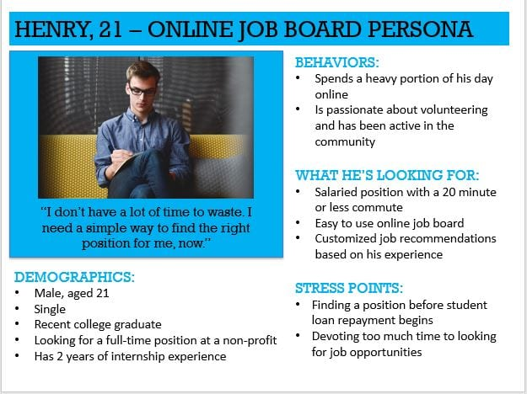
Design Thinking Tools: Persona

Slide 7
Design Thinking Tools: Customer Journey Maps
Customer Journey Maps: Online Purchase of a Product
Open the App based on requirement
Browse the products
Select the product
Check the specifications
Check the rates and Offers
Take Feedback from Neighbors or Users
Compare the Prices
Repeat the Process: Product selection, Specs, Price Discounts
Open another App
Check with Reviews of the Product
Check with Payment and Delivery Option
Check with Discounts on a Credit Card payment
Take a decision, Order and Receive the product
These maps illustrate the steps a customer takes while interacting with a product or a service

Slide 8

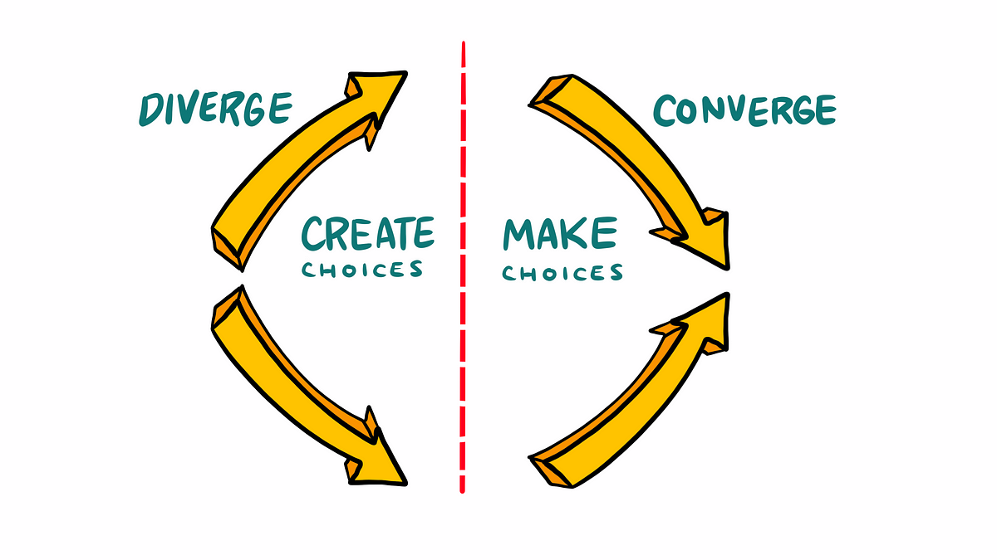

Design Thinking Tools: Brainstorming
Divergence: Bringing multiple expertise and multiple perspectives at the same time to generate ideas.
NO IDEA IS BAD

Slide 9
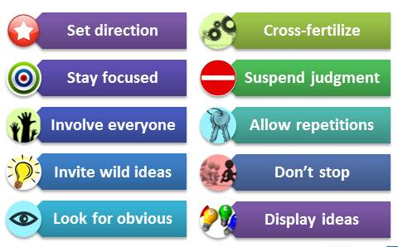
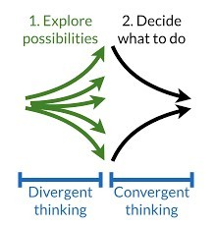
Design Thinking Tools: Brainstorming
Brainstorming is an effective way to:
Produce a large number of ideas
Generate ideas quickly
Expand your portfolio of alternatives
Get people unstuck
Inject insights from a broader group
Build enthusiasm
Solve tricky problems
Improve team collaboration
FEW TIPS

Slide 10
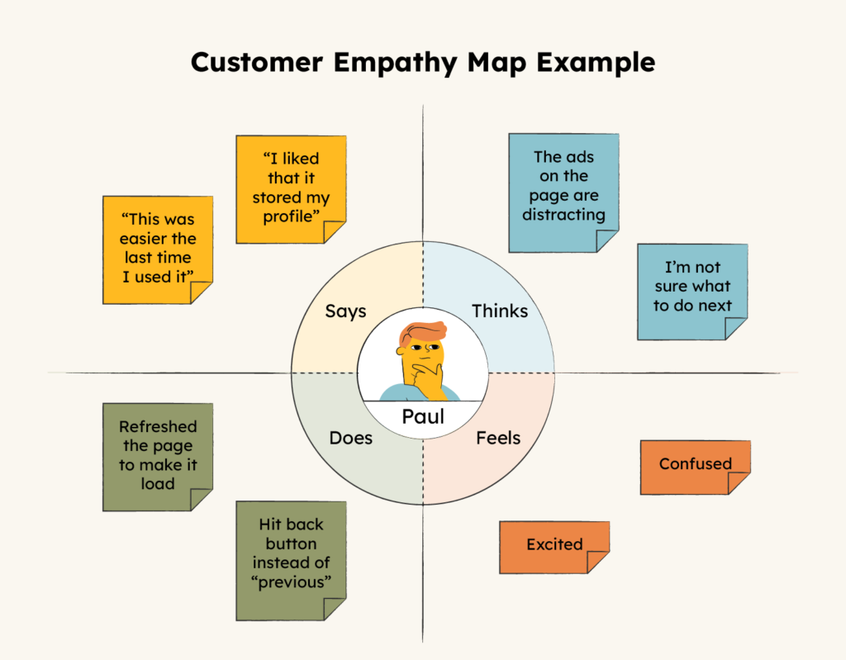
Design Thinking Tools: Customer Empathy Map
It is a visual tool that helps the teams understand the emotions, thoughts and pain points of the users
By mapping these elements, teams gain deeper insights into the user experience, fostering empathy and ensuring that design solutions effectively address user needs

Slide 11
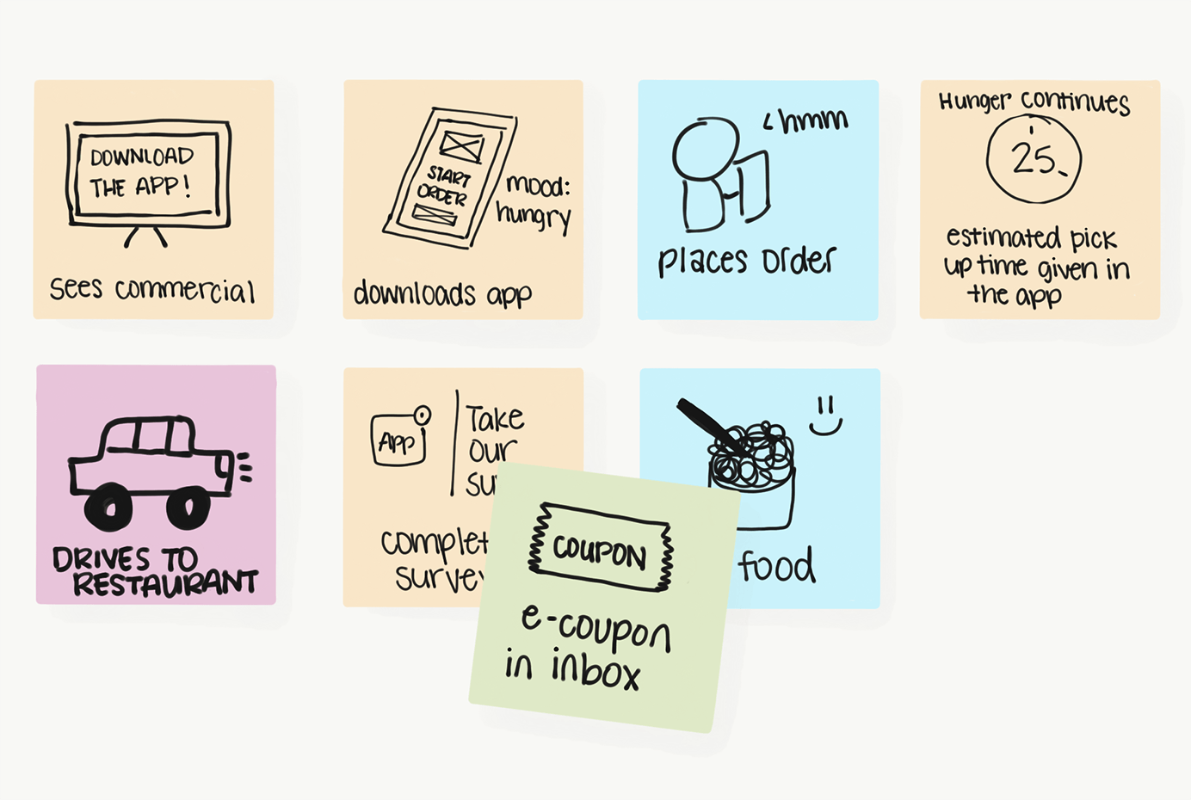
Design Thinking Tools: Story Boarding
It is a visual technique that depicts a user’s experience through a series of images or sketches
It helps communicate the user journey and potential interactions in an engaging manner for easy grasping

Slide 12
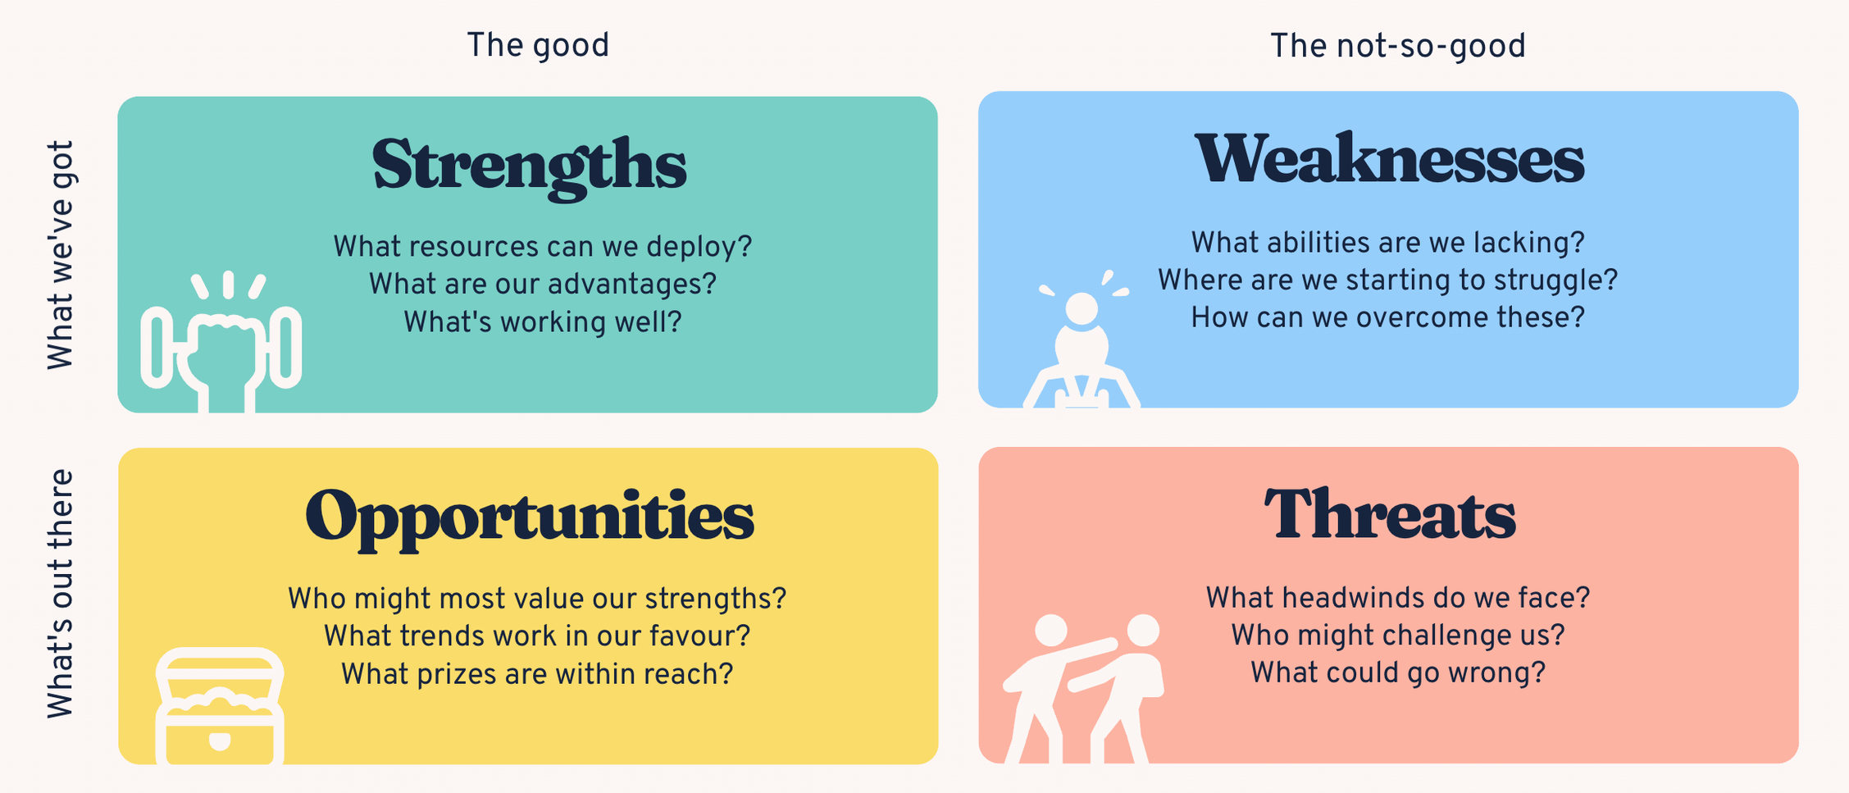
Design Thinking Tools: SWOT Analysis
It is a strategic planning method that identifies the Strengths, Weaknesses, Opportunities and Threats associated with a project or a product or service
This analysis helps in analyzing and improving the impacts of the service

Slide 13
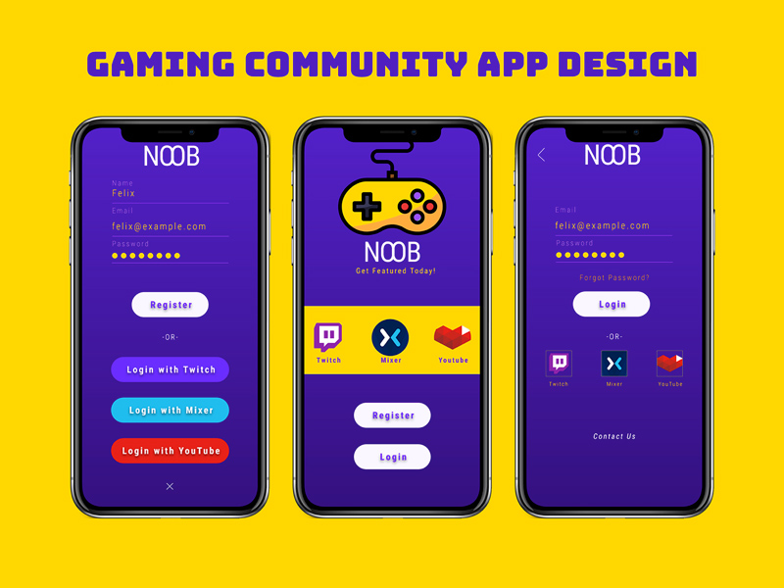
Design Thinking Tools: Prototype Tools
Prototyping Tools: Figma and Adobe XD – Software applications
Creates Visual representation of the ideas
They support development of low fidelity (rough models) and high fidelity (working models) prototypes
Facilitate rapid testing and user feedback collection from the models
The goal of a prototype is to ensure our design is effective in the hands of the user
Getting feedback on a prototype is one of the easiest and cheapest ways to get feedback, before one spends a lot of money building something that might not meet user needs
Then we will spend even more to correct the things
Creating a prototype allows design teams to hone a product concept before it's built and launched—saving time, money, and headaches for everyone involved
Adobe XD Output of a Prototype

Slide 14

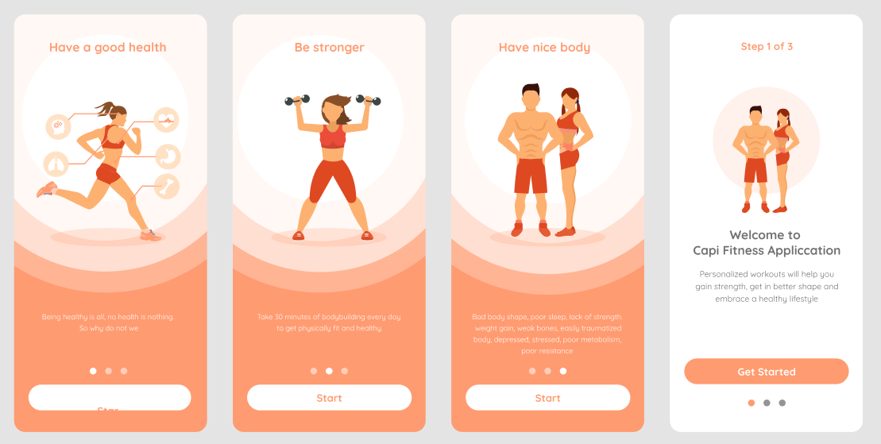
Design Thinking Tools: Prototype Tools
FIGMA Design for a Mobile App Model
Adobe XD Design for Sports/ Fitness App

Slide 15
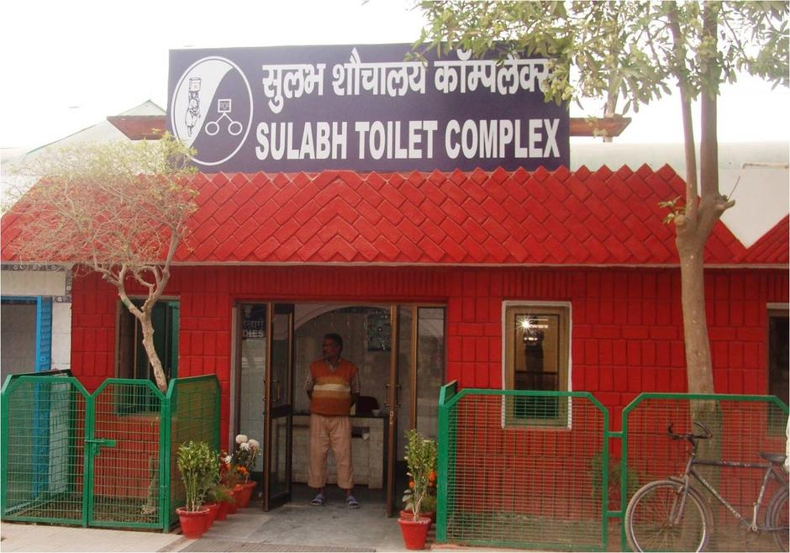
Social Innovation and Design Thinking Tools
Case Study: Sulabh Complexes
Problem: Inadequate sanitation facilities, Open defecation problems
Target group: Rural and urban population, Poor and moderate economy based public
Objectives: To improve public health and provide affordable toilet facilities
Observations:
Safety and privacy
Cultural stigma
Hygiene
Need for maintenance
Solution provided:
Community-Centric design
Pay-and-use method
Awareness for users
Regular maintenance
Biogas generation
Impact of Outcome on Society
Drastic reduction in open defecation
Increased use of Toilets
Enhanced public health

Slide 16
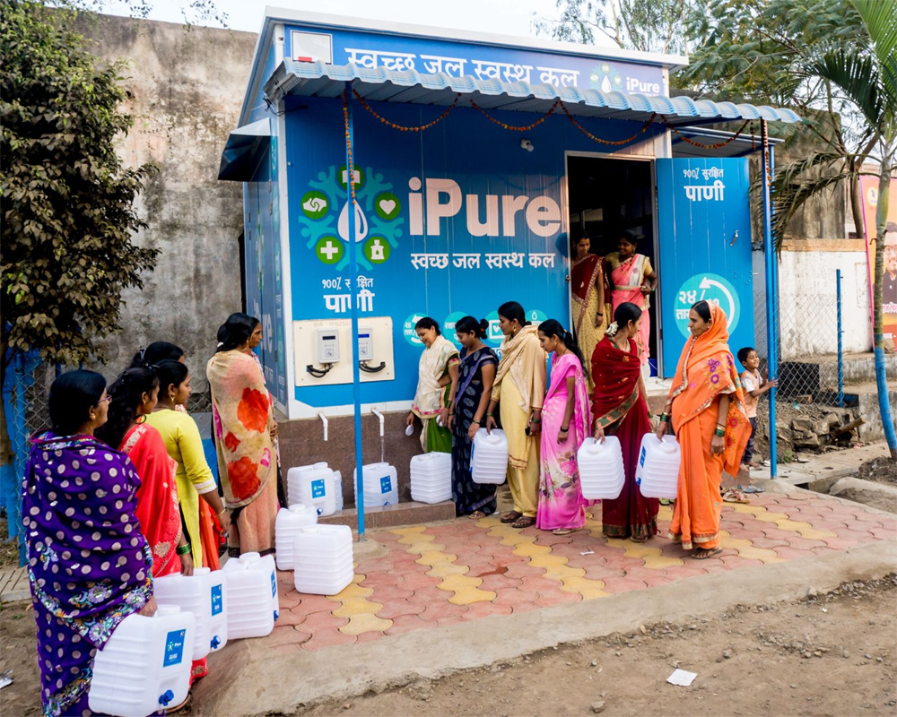
Social Innovation and Design Thinking Tools
Case Study: Naandi Foundation for Safe drinking water
Problem: Inadequate water supply facilities, Poor water quality, Associated health problems
Target group: Rural Andhra Pradesh and poor people
Objectives: To supply clean and safe water at affordable price and make it continuously available
Observations:
Connection with conventional bore wells/open wells
Poor awareness on water-borne diseases
Travelling long distances for water collection
Poor water management practices
No availability when required
Solution provided:
Community-Centric design of water treatment plants
Affordable price of water supply (Rs 2 for 20 L Bottle)
Clean and safe water at any time
Regular maintenance and participatory approach
Regular water quality checking
Impact of Outcome on Society
Increased access to safe drinking water
Improved health and no need to travel
Behavioral change and water management
Sustainable practice

Slide 17
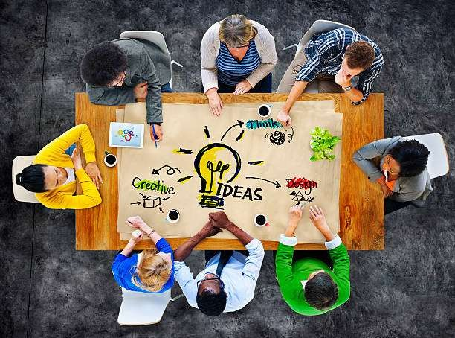
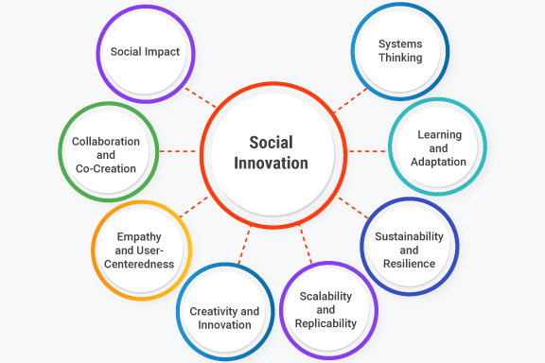

Social Innovation and Design Thinking Tools - Activity
Activity
Students should present their understanding of DTI Tools in social innovation using suitable examples in a chart

Slide 18


